Slide 1

Visual state preparation
UAB Qiskit Hackathon Barcelona 2023
Team QuPics: Guilherme, Diogo, Pau, Gerard, Boris, Bart

Slide 2
1. Textbook version
8x8 picture → 64 positions
Use 6 qubits to represent these
Add one extra qubit to represent the intensity
The rotation angle represents the intensity
Do 64 controlled rotations for all pixels
Retrieve image by tomography

Slide 3
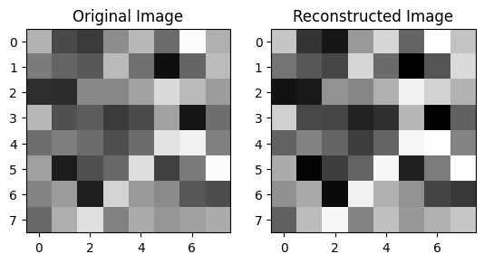
1. Textbook version
Simulated no noise image:
Depth: 8002
Squared error: 0.3

Slide 4
2. Second approach
Use 6 qubits for the 64 pixels
Now encode intensity in the probability amplitude of each state
New depth: 357

Slide 5
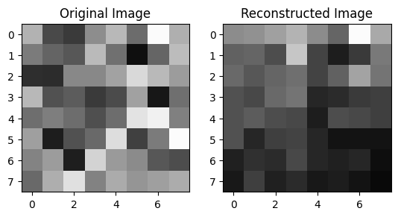
2. Second approach
Hardware image:
Depth: 357
Squared error: 7.4

Slide 6
3. Mapping method
Need to reduce depth even further
Group pixels by same/similar intensity and put them in 16 buckets
Create a 4x4 picture with these buckets and encode into a quantum state
Retrieve the image, by mapping the intensity of each bucket to the original 8x8 locations of the pixels
You would need to store this mapping key classicaly

Slide 7
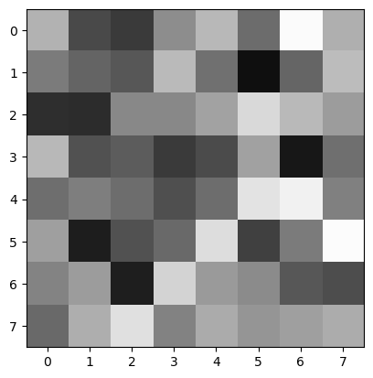
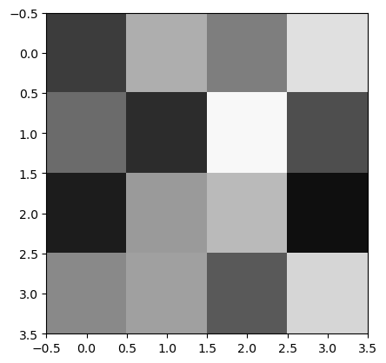
3. Mapping method
K-means method with 16 clusters:

Slide 8
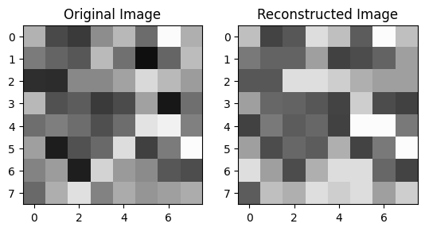
3. Mapping method
New depth: 81
Random image on hardware:
Squared error: 1.52

Slide 9
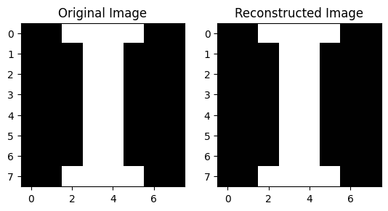
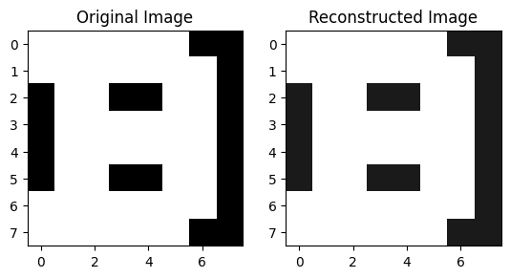
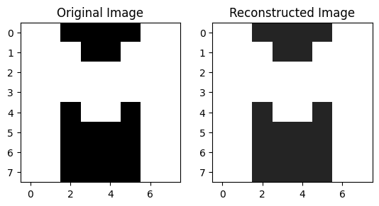
3. Mapping method
The final and most impotant test
IBM picture:

Slide 10
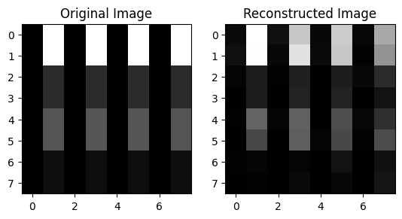
Extra: product state
When the image can be written as a product state, we can reduce depth down to 4 (!)
Image:
Squared error: 0.4

Slide 11
Thank you!

